Slide 1
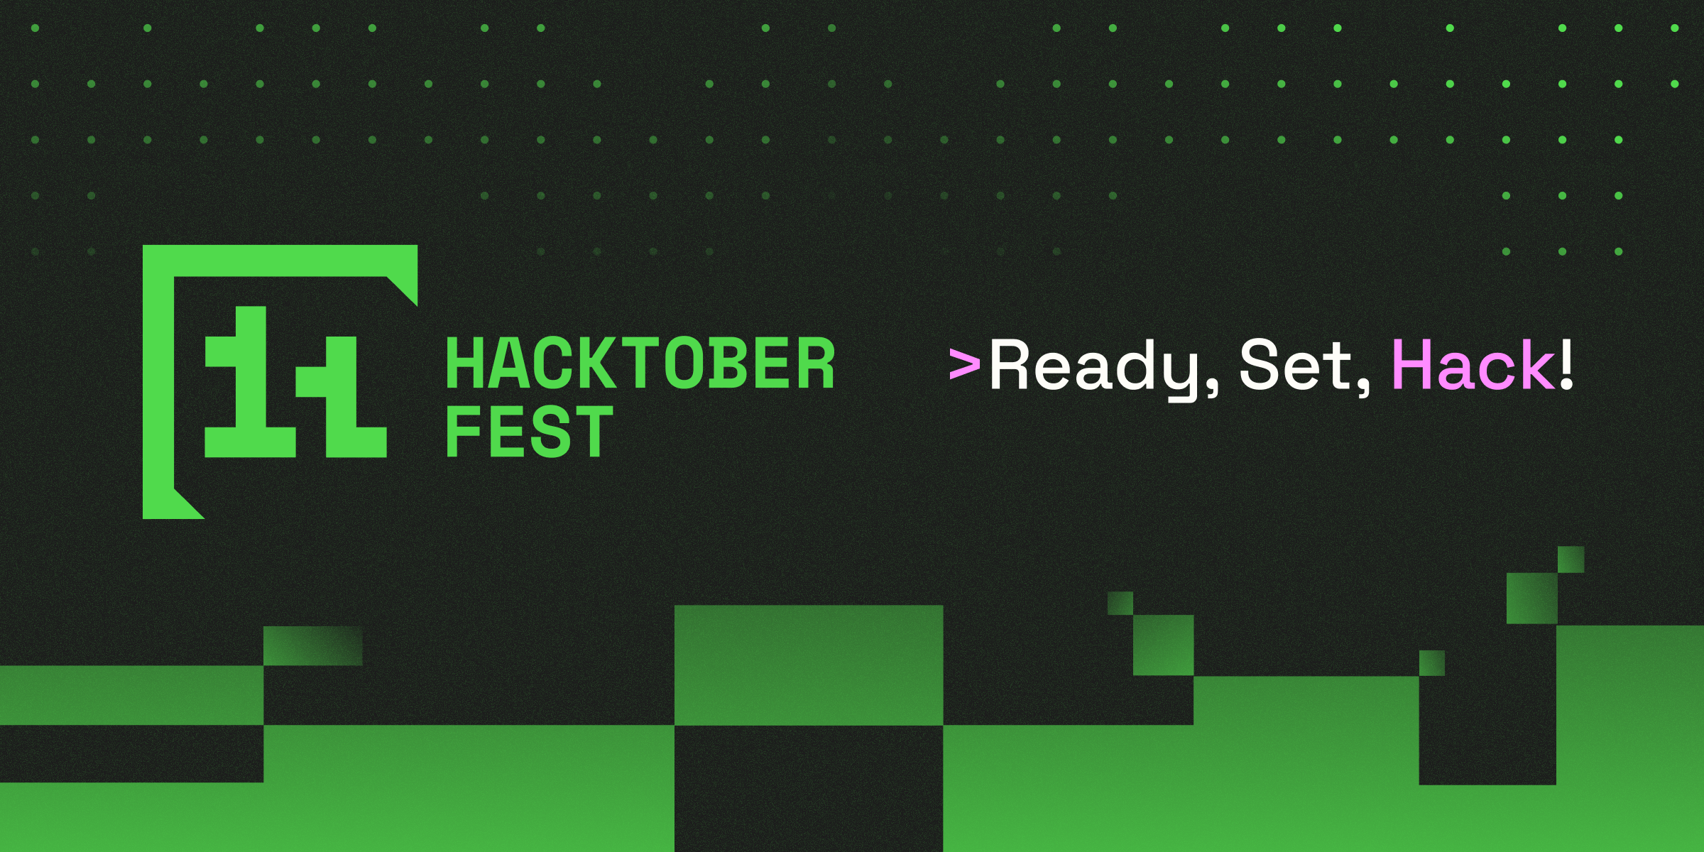


Slide 3
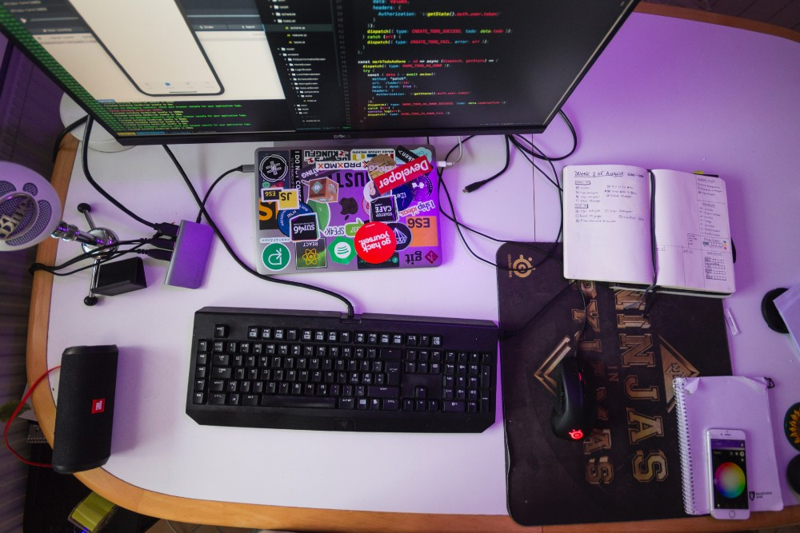


Welcome to Hacktoberfest : Community and Growth
Join a global celebration of open-source collaboration and skill-building.

Slide 4
Welcome to Hacktoberfest : Community and Growth
Join a global celebration of open-source collaboration and skill-building.

Slide 6
What is Open Source?
Understanding Hacktoberfest: Key Insights
Definition of Open Source
Promotes Collaboration
Fosters Innovation
Ensures Transparency
Global Engagement
Open source software is designed to be publicly accessible and modifiable.
Encourages developers to work together, enhancing software quality.
Allows for rapid improvements and new features through community contributions.
Users can inspect code for security and reliability, building trust.
Hacktoberfest brings developers from all over the world to contribute.
Incentivizes Participation
Diverse Projects
Skill Development
Community Building
Long-term Impact
Participants can choose from a wide range of open-source projects to contribute to.
Developers enhance their skills and learn from real-world projects.
Strengthens the open-source community through networking and collaboration.
Contributions during Hacktoberfest can lead to lasting changes in software.
Offers rewards for contributions during the Hacktoberfest event.

Slide 8
Understanding Hacktoberfest
Key Insights into a Month-Long Open Source Celebration

Slide 9
What is Hacktoberfest?
A month-long event dedicated to promoting open-source contributions.
Understanding Hacktoberfest
Participation Requirements
Participants need to submit four valid pull requests on GitHub.
Duration of the Event
Hacktoberfest takes place every October, lasting for the entire month.
Key Insights into a Month-Long Open Source Celebration
Open-Source Focus
The event emphasizes the importance of open-source project contributions.
Partners Involved
Supported by notable partners such as DigitalOcean and GitHub.

Slide 11
Importance of Version Control: Git
Understanding Hacktoberfest: Key Insights
1
2
3
4
5
Collaboration
Change Tracking
Version Management
Conflict Resolution
Extensive Use in Hacktoberfest
it enhances teamwork by allowing multiple users to work on projects simultaneously without conflicts.
Every modification made in the codebase is recorded, ensuring a comprehensive history of change
Git allows users to manage different versions of their projects, facilitating easy rollbacks if needed.
it provides tools to resolve conflicts that arise when multiple users edit the same file.
During Hacktoberfest, Git is crucial for submitting pull requests and managing contribution efficiently.
6
7
8
9
10
Distributed System
Branching and Merging
Community Engagement
Learning Resource
Open Source Contribution
As a distributed system, Git allows every user to have a complete local copy of the project repository.
Git supports branching strategies, enabling developers to work on features independently before merging.
Git fosters community involvement, making it easier for developers to collaborate on open source projects.
Hacktoberfest serves as a great learning opportunity for new developers to grasp Git and version control.
it encourages contributions to open-source projects, enhancing code quality and community growth.

Slide 13

How to Contribute: Forking and Pull Requests
Understanding the process of contributing to projects effectively
Forking a Repository
Making Changes
Contributors create a personal copy of the project to modify.
After forking, contributors can adjust the code or documentation as needed.
Submitting Pull Requests
Maintainer Review
Once changes are made, contributors submit pull requests to propose their modifications.
Project maintainers assess the pull requests for quality and relevance.
Merging Contributions
Enhancing the Project
Contributions help improve the project with new features or bug fixes.
Upon approval, maintainers merge the changes into the original project repository.

Slide 14
Best Practices for Quality Contributions
Enhancing Project Value through Effective Contributions
1
2
3
4
5
Improving Documentation
Engaging with Maintainers
Fixing Bugs
Adding Features
Following Guidelines
identify and resolve bugs to enhance software stability and user experience.
introduce new functionalities that meet user needs and improve the project’s utility.
Provide clear and concise documentation to facilitate user understanding and project navigation.
Communicate regularly with project maintainers to ensure alignment with project goals.
Adhere strictly to project contribution guidelines to maintain quality and consistency.
6
7
8
9
10
Submitting Pull Requests
Participating in Discussions
Testing Contributions
Providing Feedback
Continuous Learning
Create and submit pull requests that clearly explain changes and their benefits.
Be active in discussions to share insights and collaborate with the community.
Thoroughly test contributions before submission to ensure they meet quality standards.
Offer constructive feedback on others' contributions to foster a collaborative environment.
Stay updated on best practices and evolving standards in software development.

Slide 15





Rewards and Rules of Hacktoberfest
Understanding Hacktoberfest: Key Insights
Rewards for Participation
Focus on Quality
Collaboration Emphasis
Open Source Contribution
Engagement with Community
Earn limited edition t-shirts by submitting four meaningful pull requests.
Hacktoberfest prioritizes quality contributions over sheer volume.
Encourages genuine collaboration among developers and open-source projects.
Participants contribute to various open-source repositories during the event.
Fosters engagement and interaction within the global developer community.

Slide 16

JOIN THE OPEN-SOURCE MOVEMENT
Engage in Hacktoberfest, enhance skills, and connect with the community.

